Slide 1
A Story from BERT to SSL
Ching Chang

Slide 2
The Motivation of This Story
In GraphCL, they constructed their experiments in 4 different settings:
Semi-supervised
Unsupervised
Transfer learning
Adversarial attacks
I though that self-supervised learning = pretrain + finetune = transfer learning

Slide 3
The Goal of This Story
Learning
Transfer Learning, Multi-task Learning
Self-supervised Learning
Semi-supervised Learning, Self Learning
Methodology
Self-SL
SimCLR, MoCo v2, BYOL, SimSiam
Semi-SL
Π-model, Temporal Ensembling, Mean Teachers, Noisy Student, Unbiased Teacher

Slide 4
Outline
Let’s start with BERT
(Deep Dive) First SSL: Self-supervised Learning
(Deep Dive) Second SSL: Semi-supervised Learning

Slide 5
Outline
Let’s start with BERT
(Deep Dive) First SSL: Self-supervised Learning
(Deep Dive) Second SSL: Semi-supervised Learning

Slide 6
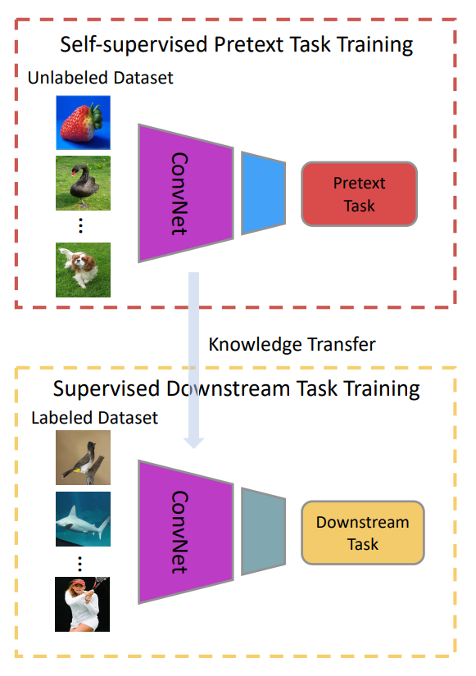
Terminology
Pretrain
Pretrain vs. Finetune
Pretext task vs. Downstream task
The purpose of self-supervised learning:
Learn a strong feature extractor
Finetune
Jing, Longlong, and Yingli Tian. "Self-supervised visual feature learning with deep neural networks: A survey." IEEE transactions on pattern analysis and machine intelligence 43.11 (2020): 4037-4058.

Slide 7
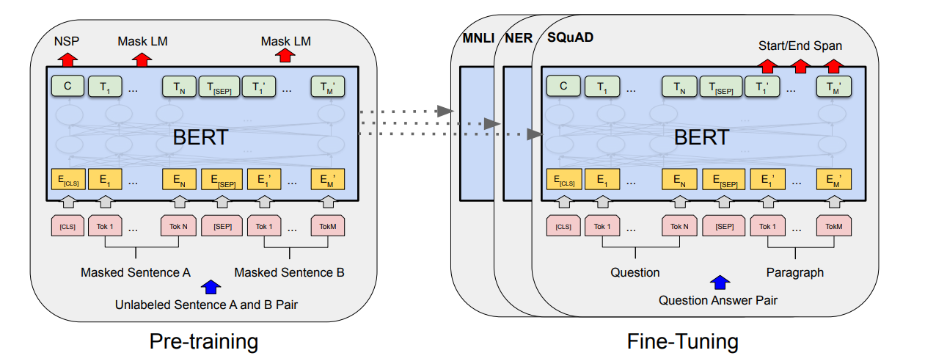
Let’s start with BERT
Unlabeled data
Labeled data
Devlin, Jacob, et al. "Bert: Pre-training of deep bidirectional transformers for language understanding." arXiv preprint arXiv:1810.04805 (2018).

Slide 8
Let’s start with BERT
Unlabeled data
Labeled data
Two tasks:
Masked LM
Next Sentence Prediction
We use the data itself to be the label as well
→ Self-supervised Learning

Slide 9
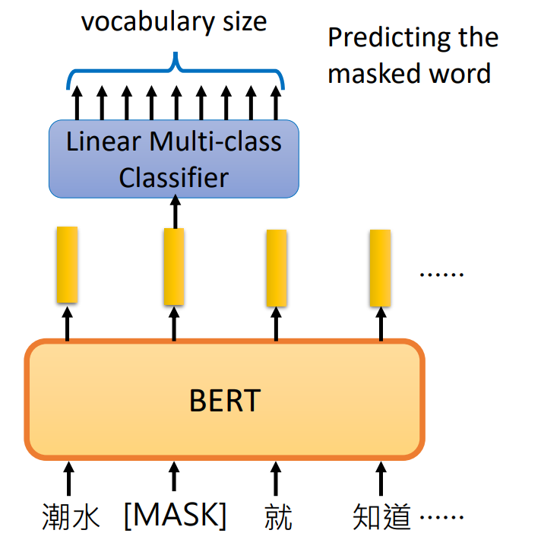
Let’s start with BERT
Pretext task
Unlabeled data
Labeled data
Two tasks:
Masked LM
Next Sentence Prediction
We use the data itself to be the label as well
→ Self-supervised Learning

Slide 10
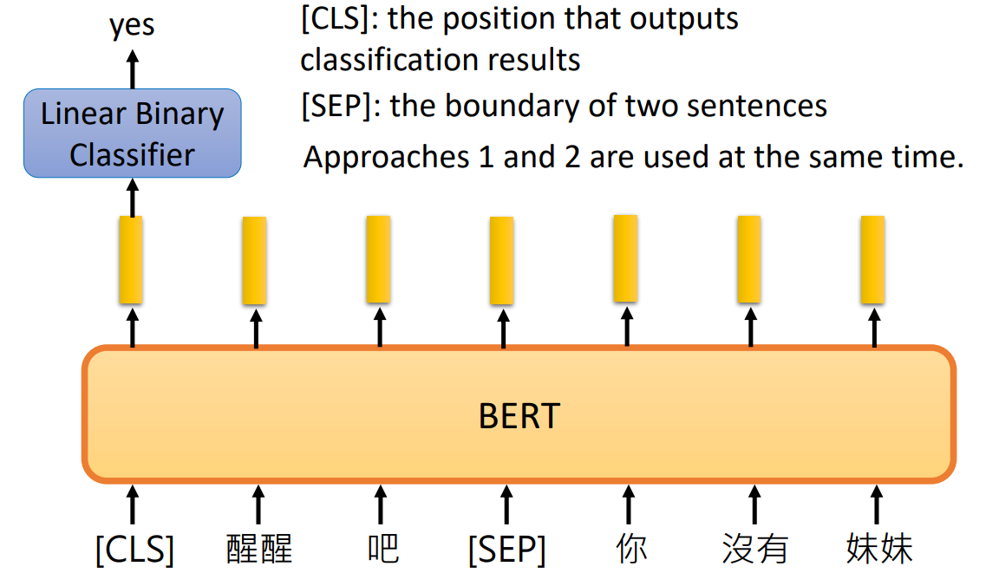
Let’s start with BERT
yes/no
Pretext task
Unlabeled data
Labeled data
Two tasks:
Masked LM
Next Sentence Prediction
We use the data itself to be the label as well
→ Self-supervised Learning

Slide 11
Let’s start with BERT
Unlabeled data
Labeled data
Use a pretrained model to finetune downstream tasks
→ Transfer Learning

Slide 12
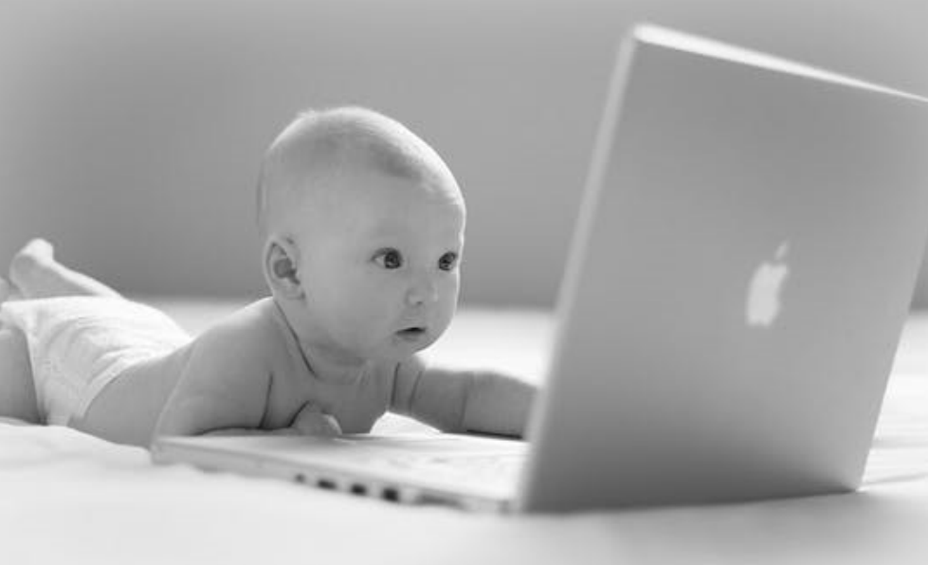
What is Self-supervised Learning (SSL)?
A form of unsupervised learning where the data provides the supervision

Slide 13
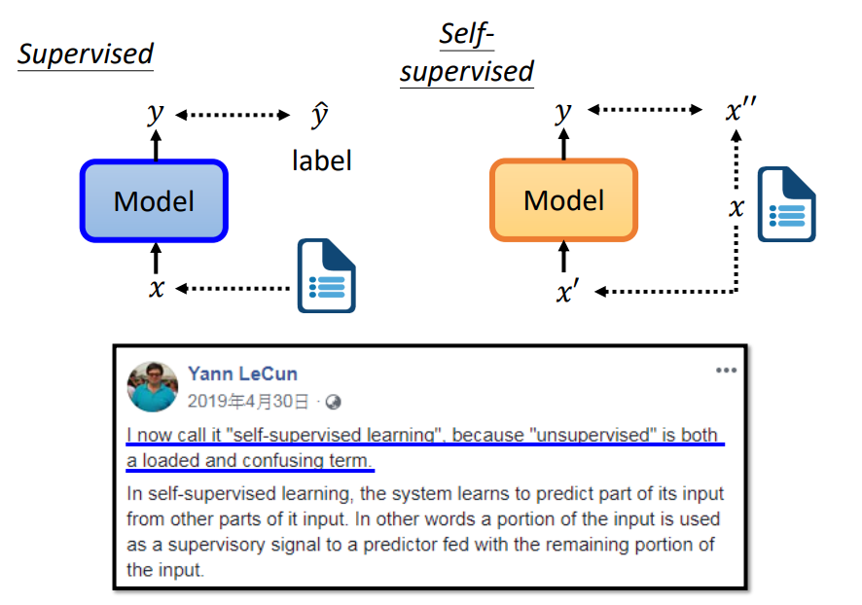
What is Self-supervised Learning (SSL)?

Slide 14
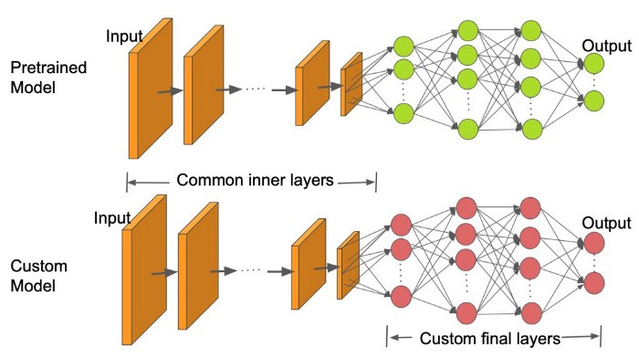
What is Transfer Learning?
The important part is using different dataset!
Can be either unsupervised or supervised
Can be either unsupervised or supervised

Slide 15
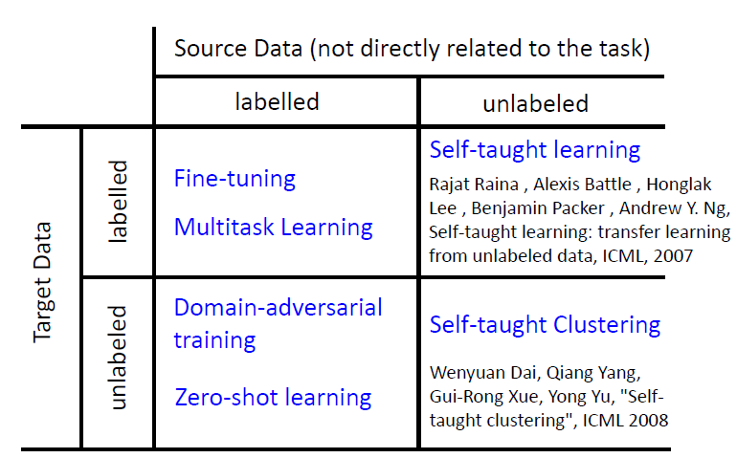
What is Transfer Learning?

Slide 16
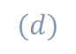
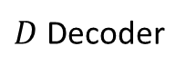
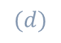
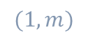
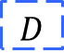
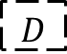
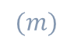
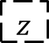
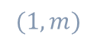
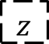
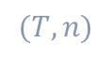
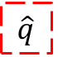
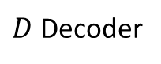
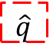
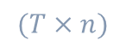
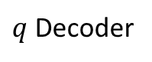
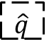
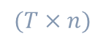
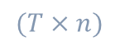

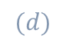
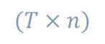
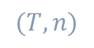
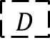
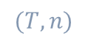
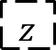
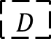
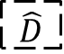
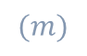
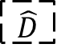

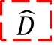
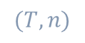

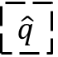
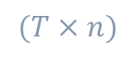

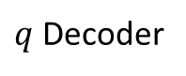
A Thin Line Between Multi-task Learning and Transfer Learning (in terms of architecture)
$$D$$
Reshape
$$D$$
Encoder
$$z$$
$D$ Decoder
$$\hat{D}$$
Reshape
$$\hat{D}$$
$$(T, n)$$
$$(T×n)$$
$$(d)$$
$$(T×n)$$
$$(T,n)$$
$$D$$
Reshape
$$D$$
Encoder
$$z$$
$q$ Decoder
$$\hat{q}$$
Reshape
$$\hat{q}$$
$$(T, n)$$
$$(T×n)$$
$$(d)$$
$$(m)$$
$$(1,m)$$
Transfer Learning
Multi-task Learning
$$D$$
Reshape
$$D$$
Encoder
$$z$$
$D$ Decoder
$$\hat{D}$$
Reshape
$$\hat{D}$$
$$(T, n)$$
$$(T×n)$$
$$(d)$$
$$(T×n)$$
$$(T,n)$$
$q$ Decoder
$$\hat{q}$$
Reshape
$$\hat{q}$$
$$(m)$$
$$(1,m)$$

Slide 17
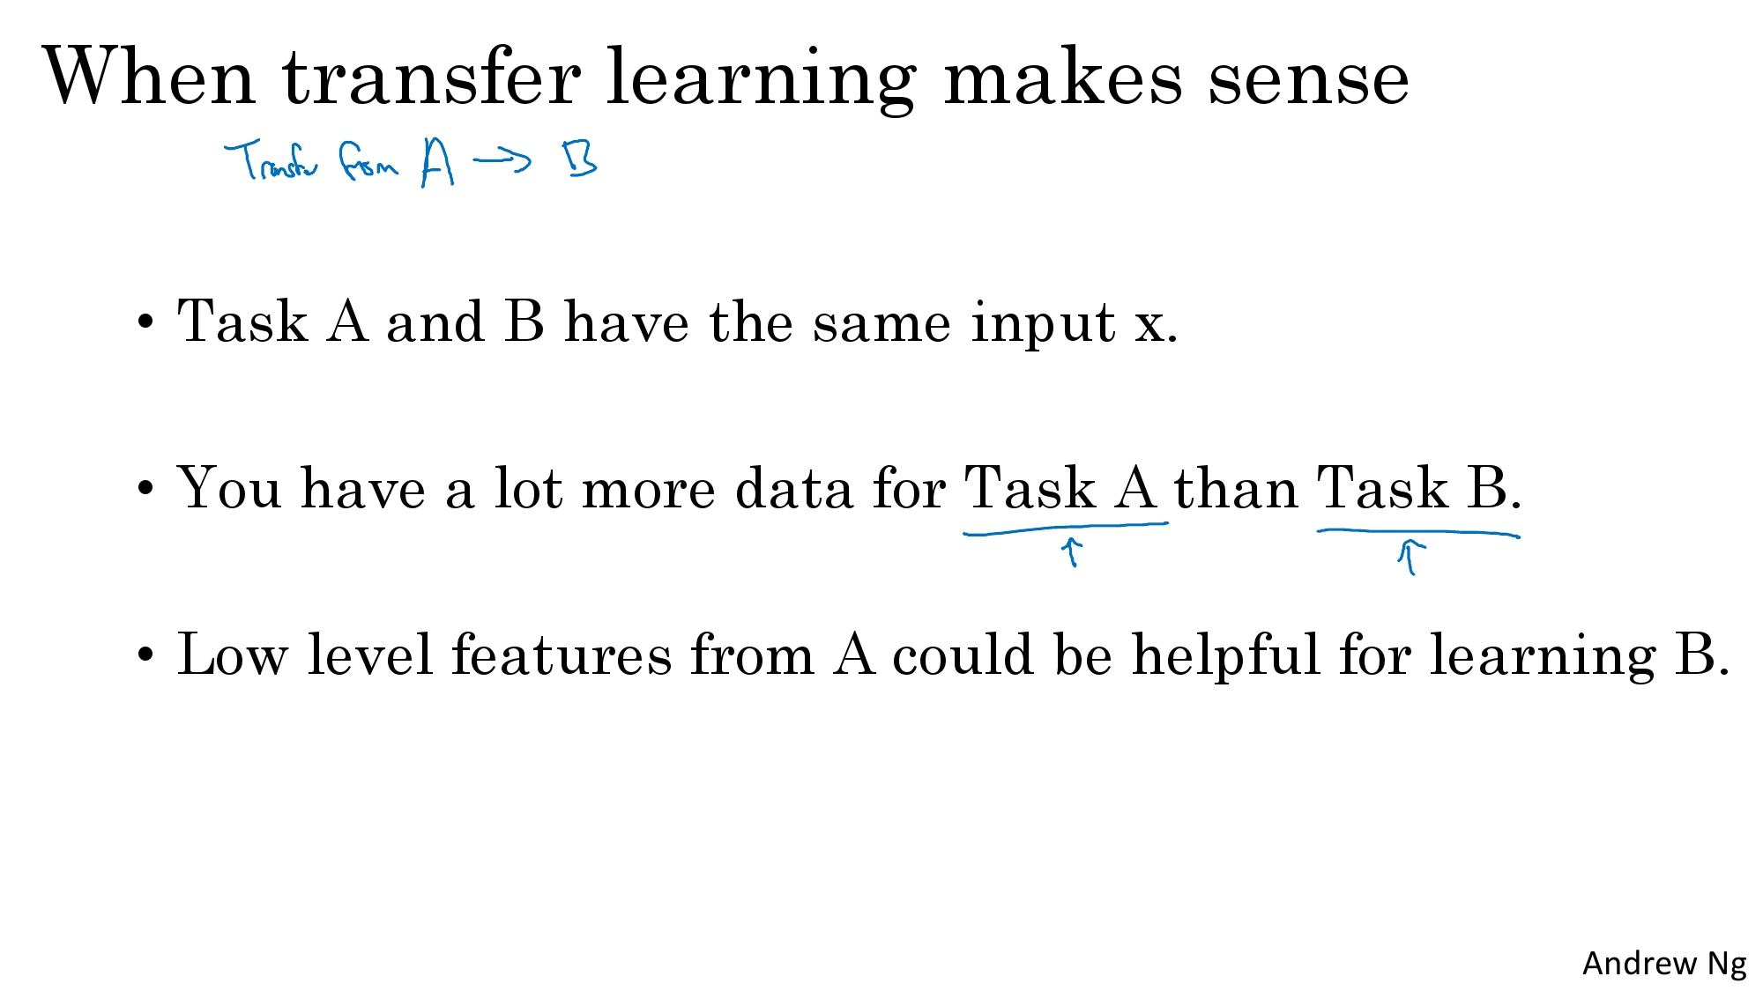
Why Do We Need Transfer Learning?
Transfer from Task A to Task B

Slide 18
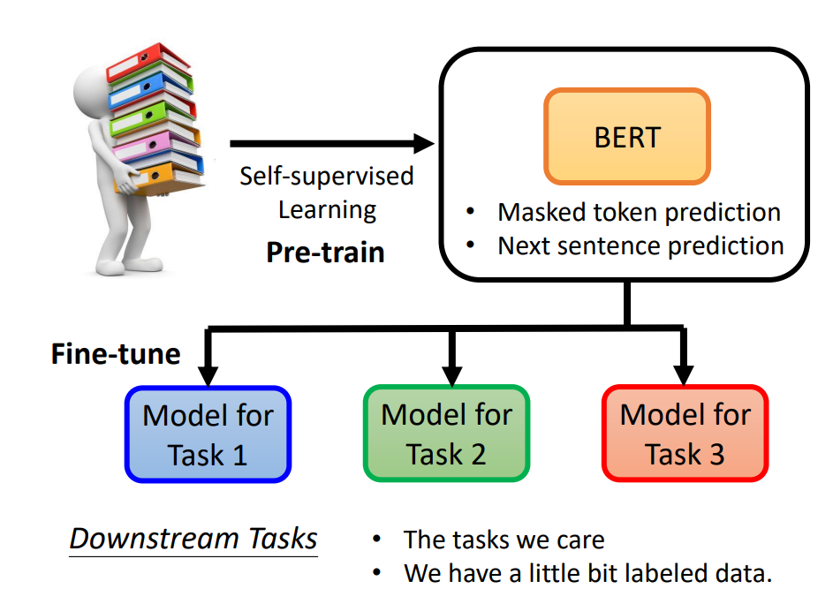
BERT with Downstream Tasks = Self-supervised Learning + Transfer Learning
Unlabeled data
+
Labeled data
=
Semi-supervised Learning
Why don’t we hear from this perspective?
Because these are different datasets.

Slide 19
Outline
Let’s start with BERT
(Deep Dive) First SSL: Self-supervised Learning
(Deep Dive) Second SSL: Semi-supervised Learning

Slide 20
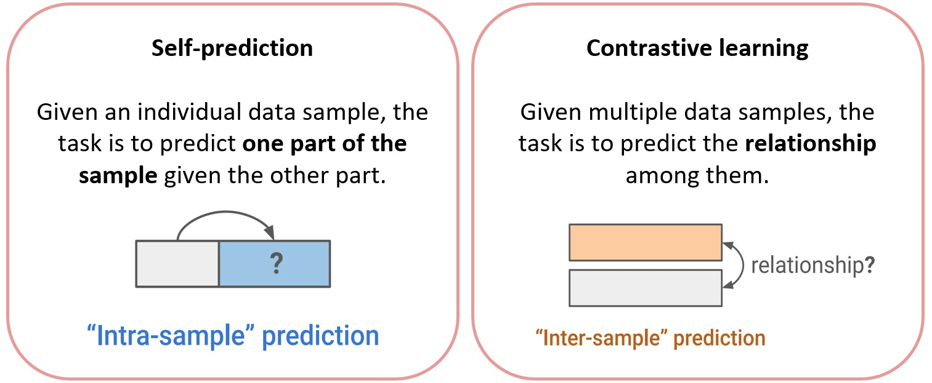
2 Methods of Self-supervised Learning

Slide 21
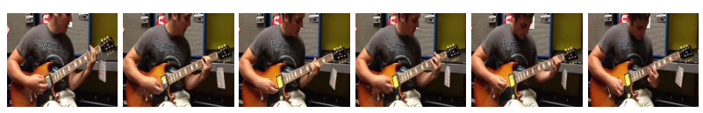
2 Methods of Self-supervised Learning
Pretext tasks
Very intuitive for CV and NLP
NLP: BERT (Masked LM)
CV:
AutoEncoder is in this category as well!

Slide 22

2 Methods of Self-supervised Learning
SimCLR

Slide 23
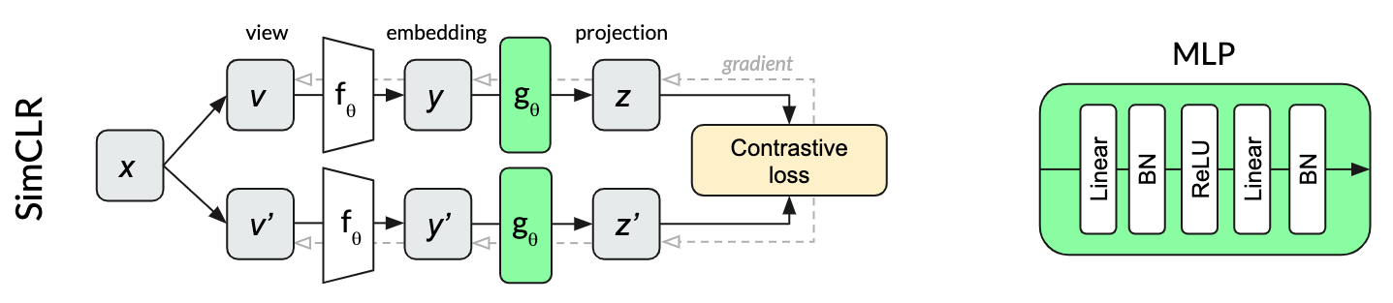
SimCLR
Maximize the representation similarity of the positive pair, while minimize the negatives
The non-linear layer helps a lot to improve the performance
Chen, Ting, et al. "A simple framework for contrastive learning of visual representations." International conference on machine learning. PMLR, 2020.

Slide 24
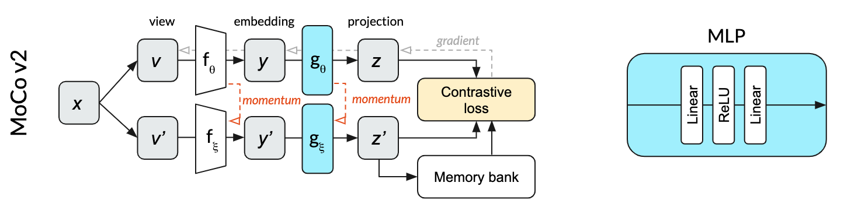
MoCo v2
Memory bank to store representation
Momentum update momentum encoder from online encoder
Chen, Xinlei, et al. "Improved baselines with momentum contrastive learning." arXiv preprint arXiv:2003.04297 (2020).

Slide 25
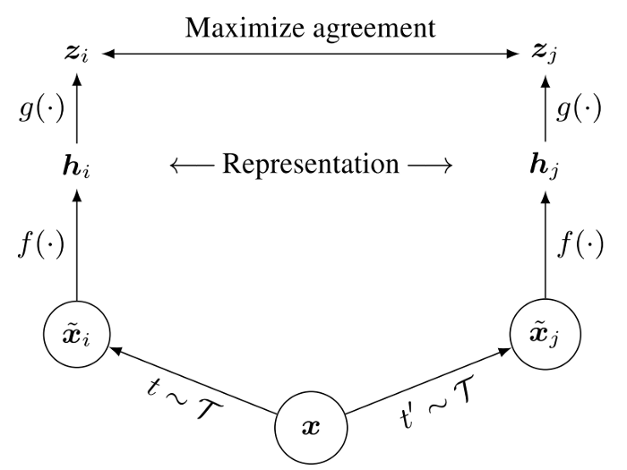
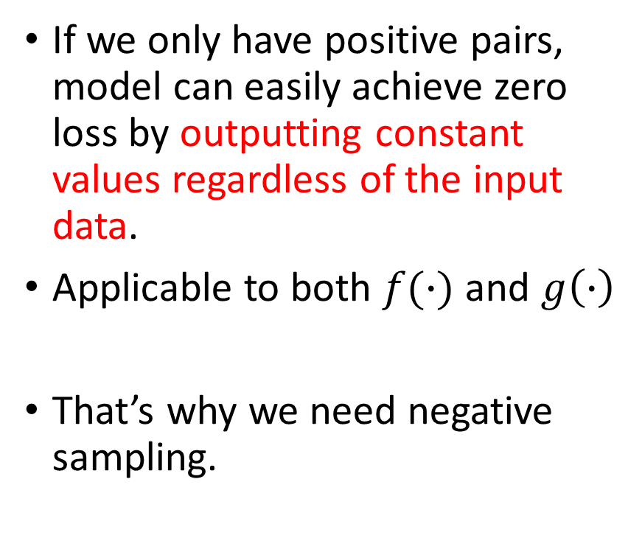
SimCLR without negative pairs = collapsing output
If we only have positive pairs, model can easily achieve zero loss by outputting constant values regardless of the input data.
Applicable to both $f(∙)$ and $g\left(∙\right)$
That’s why we need negative sampling.

Slide 26

BYOL
Why won’t we suffer from collapsing output?
Because we don’t update both encoders at once.
(Like GAN, we separately update the generator and discriminator)
We don’t need negative pairs, and we don’t suffer from collapsing output
Additional prediction layer
Grill, Jean-Bastien, et al. "Bootstrap your own latent-a new approach to self-supervised learning." Advances in neural information processing systems 33 (2020): 21271-21284.

Slide 27

SimSiam
Why won’t we suffer from collapsing output?
Because we don’t update both encoders at once.
(Like GAN, we separately update the generator and discriminator)
BYOL without momentum encoder
SimSiam
Chen, Xinlei, and Kaiming He. "Exploring simple siamese representation learning." Proceedings of the IEEE/CVF Conference on Computer Vision and Pattern Recognition. 2021.

Slide 28
SimSiam

Slide 29
Outline
Let’s start with BERT
(Deep Dive) First SSL: Self-supervised Learning
(Deep Dive) Second SSL: Semi-supervised Learning

Slide 30



Another SSL: Semi-supervised Learning
Semi-supervised learning uses both labeled and unlabeled data to train a model.
All the methods introduced later have a loss combining two parts:
$L=L_{s}+u\left(t\right)L_{u}$
Same datasets
supervised loss
unsupervised loss

Slide 31
Another SSL: Semi-supervised Learning
Consistency Regularization
Π-model, Temporal Ensembling, Mean Teachers
Pseudo Labeling (Entropy Minimization)
Noisy Student (Self Training)
Consistency Regularization + Pseudo Labeling
MixMatch, ReMixMatch, FixMatch, Unbiased Teacher
Ouali, Yassine, Céline Hudelot, and Myriam Tami. "An overview of deep semi-supervised learning." arXiv preprint arXiv:2006.05278 (2020).

Slide 32


Π-model
Consistency Regularization assumes that randomness within the neural network (e.g. with Dropout) or data augmentation transformations should not modify model predictions given the same input.
This idea has been adopted in several self-supervised learning methods, such as SimCLR, BYOL
Laine, Samuli, and Timo Aila. "Temporal ensembling for semi-supervised learning." arXiv preprint arXiv:1610.02242 (2016).

Slide 33


Laine, Samuli, and Timo Aila. "Temporal ensembling for semi-supervised learning." arXiv preprint arXiv:1610.02242 (2016).

Slide 34

Temporal Ensembling
Π-model requests the network to run two passes per sample, doubling the computation cost.
Laine, Samuli, and Timo Aila. "Temporal ensembling for semi-supervised learning." arXiv preprint arXiv:1610.02242 (2016).

Slide 35

Mean Teachers
Temporal Ensembling: average label predictions
Mean Teachers: average model weights
Student Learning
Teacher Refinement
We want to keep Teacher.
Tarvainen, Antti, and Harri Valpola. "Mean teachers are better role models: Weight-averaged consistency targets improve semi-supervised deep learning results." Advances in neural information processing systems 30 (2017).

Slide 36

Teacher-Student Learning ≡ Knowledge Distillation
As was: model compression
As is: model accuracy improvement
Yuan, Li, et al. "Revisiting knowledge distillation via label smoothing regularization." Proceedings of the IEEE/CVF Conference on Computer Vision and Pattern Recognition. 2020.

Slide 37


Normal KD
strong
teach
weak
Hinton, Geoffrey, Oriol Vinyals, and Jeff Dean. "Distilling the knowledge in a neural network." arXiv preprint arXiv:1503.02531 2.7 (2015).

Slide 38


Reversed KD – Noisy Student
weak
teach
strong
Xie, Qizhe, et al. "Self-training with noisy student improves imagenet classification." Proceedings of the IEEE/CVF conference on computer vision and pattern recognition. 2020.

Slide 39

Unbiased Teacher
Noisy Student + Mean Teachers + Focal Loss
Liu, Yen-Cheng, et al. "Unbiased teacher for semi-supervised object detection." arXiv preprint arXiv:2102.09480 (2021).

Slide 40
SimCLRv2
Chen, Ting, et al. "Big self-supervised models are strong semi-supervised learners." Advances in neural information processing systems 33 (2020): 22243-22255.

